Slide 1

INNOBI BUSINESS INTELLIGENCE SERVICES
Business Intelligence Services, October 2024, © INNOBI Software

Slide 2

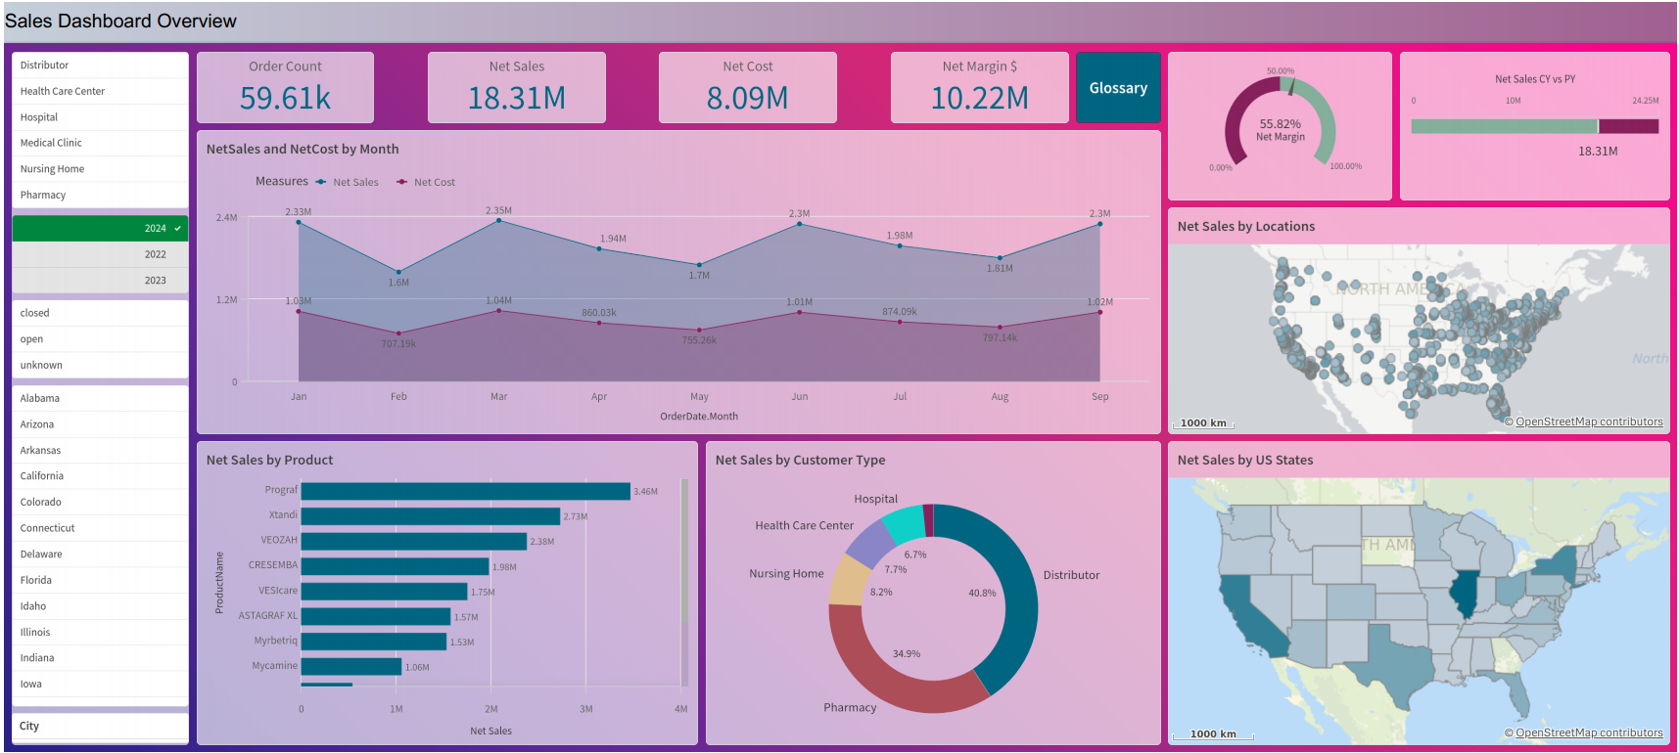
QlikSense - Sales Dashboard , 2024 Selected
Filter Pane to select the most important Dimensions
KPI Cards to show the most important KPIs
Glossary Button to go to the Company Dimension and Measure definitions page,
Go to Page 4 for details
Gauge Charts to set targets for specific KPIs and to show complete the KPI target is
2
Bar Chart to show the Products Sales
Line Chart to follow the monthly trend of Sales and Costs
Pie Chart to compare the Sales of Customer Types
Map Charts to compare the Sales of States(Territories) by dynamic color expression
Business Intelligence Services, October 2024, © INNOBI Software

Slide 3
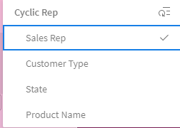
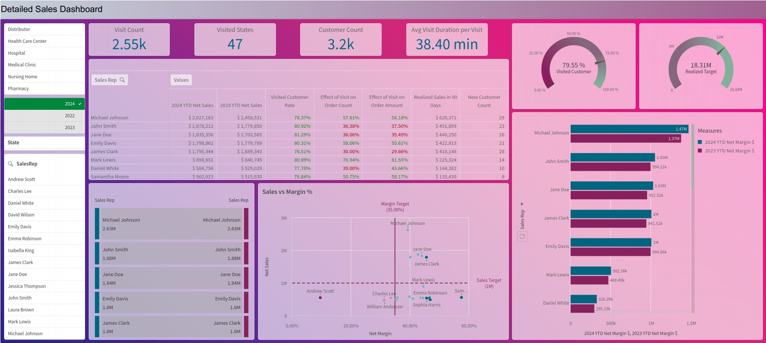
QlikSense – Detailed Sales Dashboard, 2024 Selected
Straight Table to show the set analysis KPIs
Cyclic Group to change the Dimension of all charts with one click
3
Sankey Chart to show the Sales Flow from between 2 Dimensions.
Scatter Plot to observe and understand the Correlation between 2 Measures.
Bar Chart to compare the Current YTD Net Sales and Prior YTD Net Sales
Business Intelligence Services, October 2024, © INNOBI Software

Slide 4
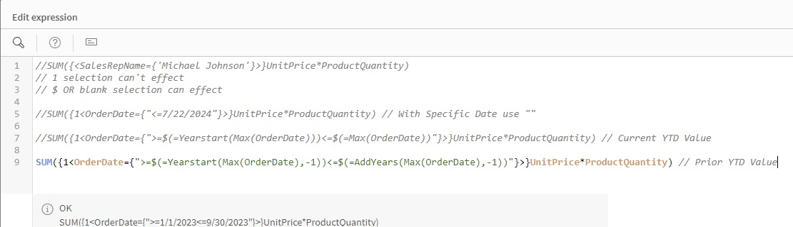
QlikSense – Set Analysis
4
Business Intelligence Services, October 2024, © INNOBI Software

Slide 5
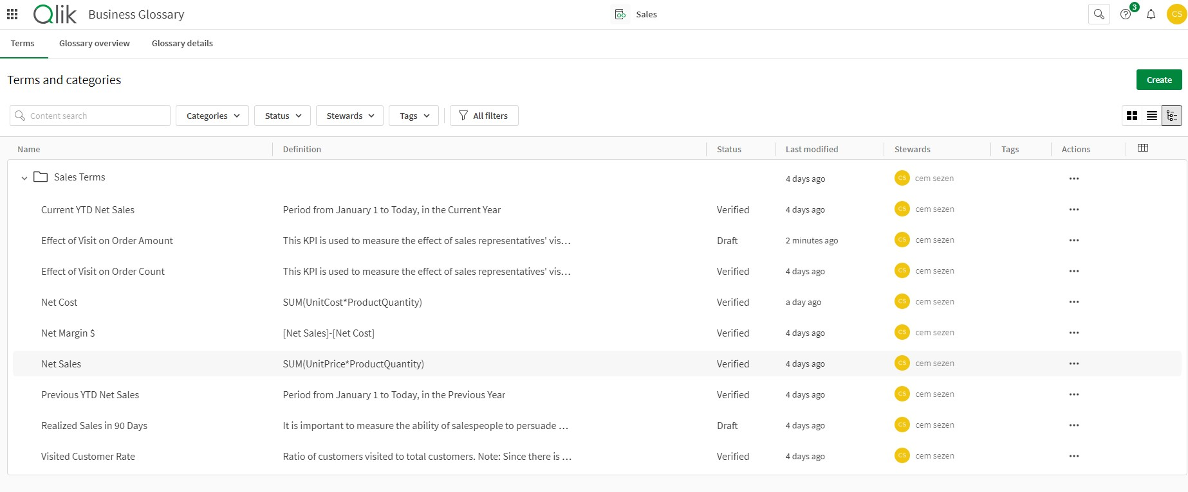
QlikSense – Business Glossary
When you click on the Glossary button, you can access Business Glossary page.
Gategories to group the explanation. Ie. Sales, Accounting, Shipping etc. Terms
Stewards to assign stakeholders to edit the Business Glossary.
5
Name to name the explanations.
Definition to define the terms, KPIs or formulas and to add explanations
Status to define the Status of the term, if all stakeholders agree to use it, you change the status from Draft to Verified.
Business Intelligence Services, October 2024, © INNOBI Software

